Slide 1








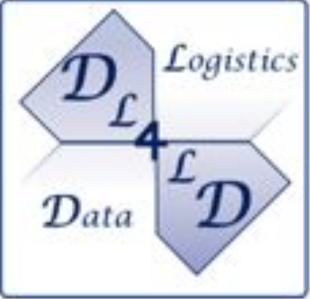

DYNAMOS:
Dynamically Adaptive Microservice-based OS
A Middleware for data-exchange marketplaces
Jorrit Stutterheim
Ana Oprescu
Thomas van Binsbergen

Slide 2

About me
Education Master Software Engineering - University of Amsterdam (2023) Thesis: DYNAMOS
Work Cloud consultant - developer - devops engineer - hotel manager Personal Born in ‘87 Lives in Utrecht

Slide 3
Data exchange marketplaces
Use cases:
SQL data analysis (hospitals, universities)
Federate Machine Learning (airlines, predictive maintenance)
Sharing anonymous sensor data (smart buildings)
AMdEX translates your data sharing agreements into machine-readable policies, that can automatically be enforced.

Slide 4
Create dynamic data exchange scenarios
Using a set of core data exchange microservices
Some challenges
A distributed data marketplace
Compose different service patterns per request
Dynamically adapt data-exchange patterns
Comply with legal policy
Notes:
The idea was, create a set of core microservices, and compose these in different configurations to allow data exchange

Slide 5

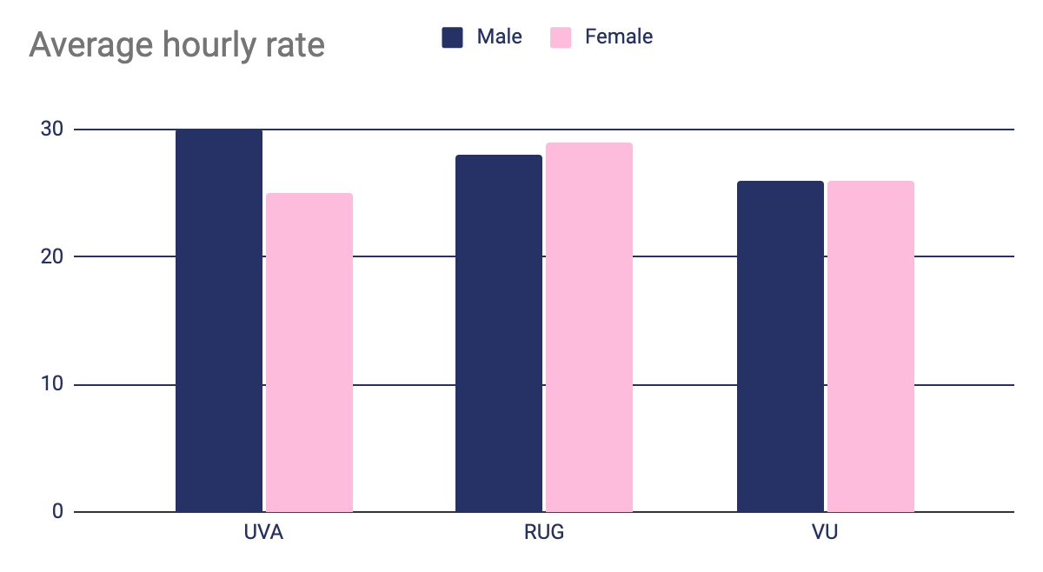
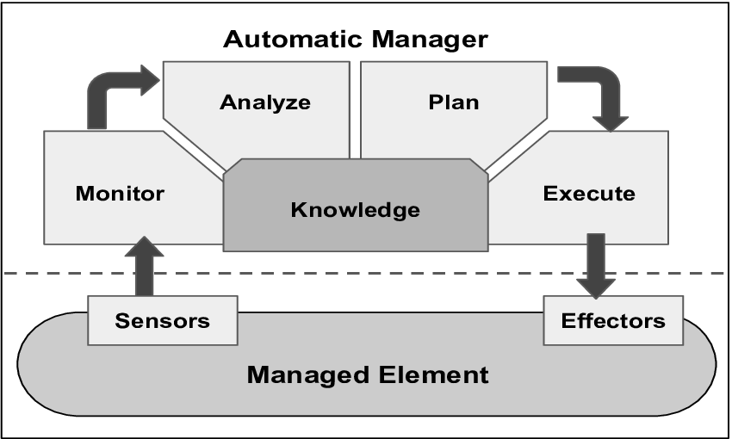
DYNAMOS offers
Easy setup through testbeds
Data is passed from one microservice to another using a uniform interface
Self-adaptivity through MAPE-K feedback loops

Slide 6

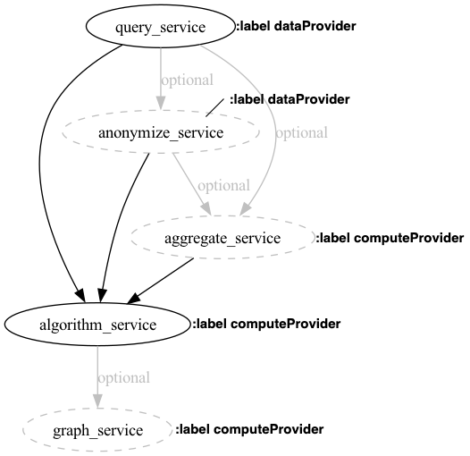
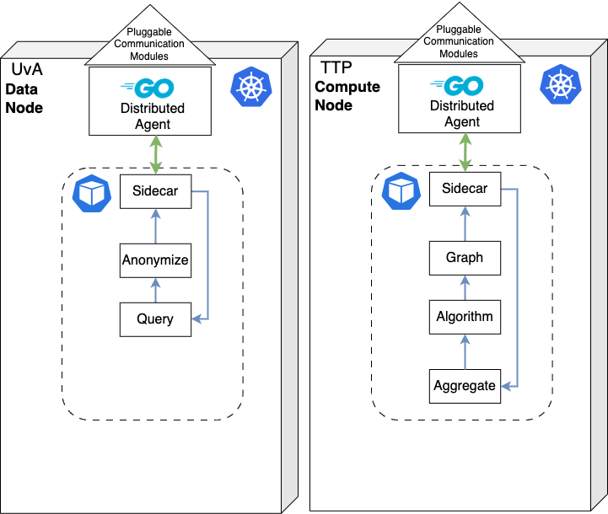
How it works
1.
Check policy and additional requirements
2. Generate microservice chain
3.
Create ephemeral data-exchange job(s)

Slide 7
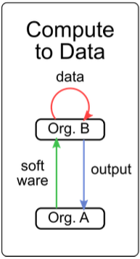

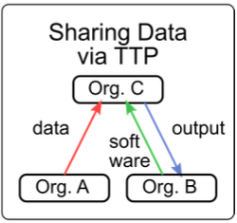



DEMO
Data
Data
Data
Data
Algorithm
Algorithm
Result
Algorithm
Result
Result

Slide 8
DEMO
Data
Data
Data
Data
Algorithm
Algorithm
Result
Algorithm
Result
Result

Slide 9
Future research
Utah (Data node)
Link Fabric into DYNAMOS for full distributed scenarios and large data sets
Experiment with security and networking components
Experiment with different data exchange scenarios
Handle microservice distribution?
Node connection on demand?
Wisconsin
(Compute node)

Slide 10
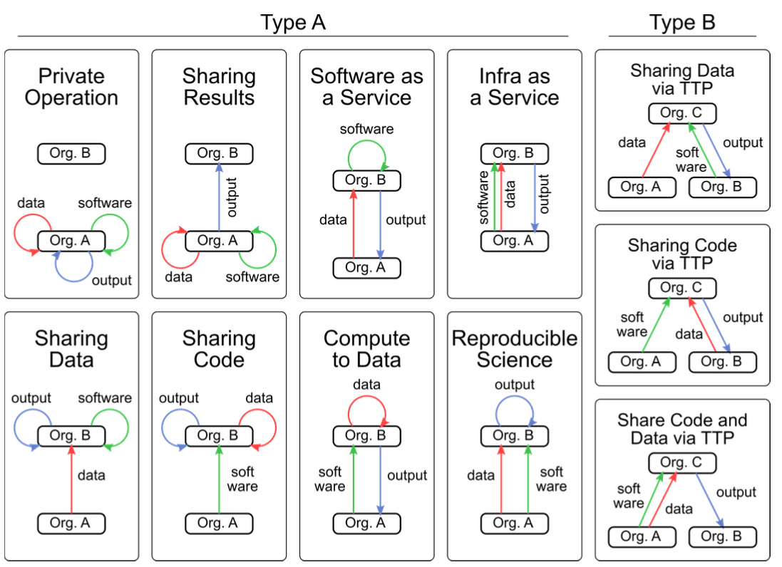
How to use
*
1.
Install or clone DYNAMOS profile
2.
Clone DYNAMOS
3.
Start experiments
* Shakeri, S., Veen, L.E., & Grosso, P. (2020). Evaluation of Container Overlays for Secure Data Sharing. 2020 IEEE 45th LCN Symposium on Emerging Topics in Networking (LCN Symposium), 99-108.

